Slide 1
Cartesian Plane MATH CAT Lucas Wan

Slide 2
Contents
Part 1 Grief
Part 2 Denial
Part 3 Bargaining
Part 4 Depression
Part 5 Acceptance

Slide 3
Github
ThatDaven/Y8-CAT-Inv1-Lucas-Wan (github.com)
Clearly see commit history
Read commit notes
Readme.md
Look through code to confirm it was written
See tried effort on visual implementation (still don’t understand how it doesn’t work)
See visual.py

Slide 4

Part 1.1: Create and explain a reusable means of achieving translations (10 Marks)

Slide 5
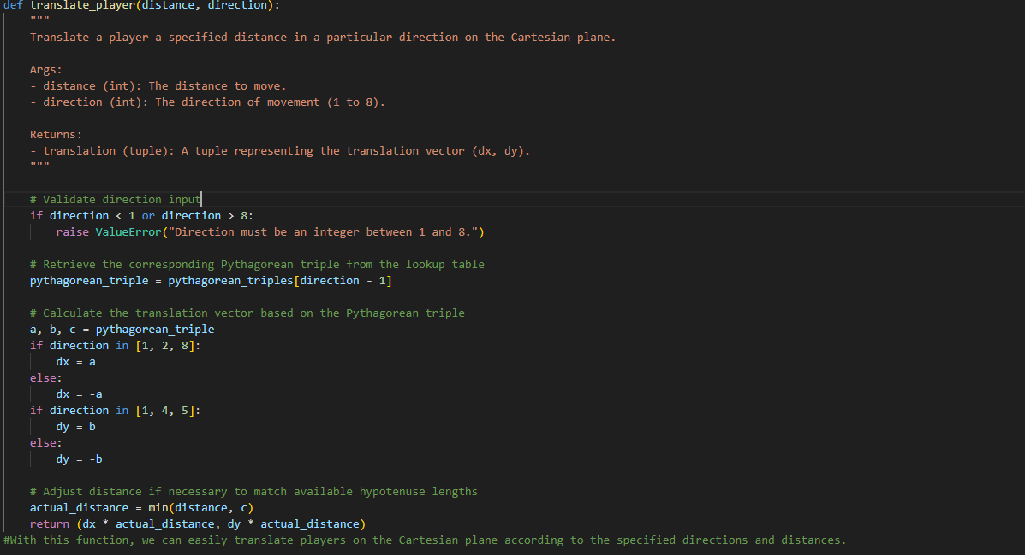
Explanation
Lookup Table Creation: A lookup table that maps each direction (1 to 8) to the corresponding Pythagorean triple (a, b, c). This table will help us quickly determine the appropriate translation for each direction.
Translation Function: A function that takes the desired distance and direction as inputs. Using the lookup table, it will identify the corresponding Pythagorean triple and calculate the translation vector accordingly.
Error Handling: Error handling to ensure that the input direction is within the valid range (1 to 8) and that the distance is non-negative.

Slide 6
Part 1.2: Use functions, validate input and document imports (10 Marks)

Slide 7
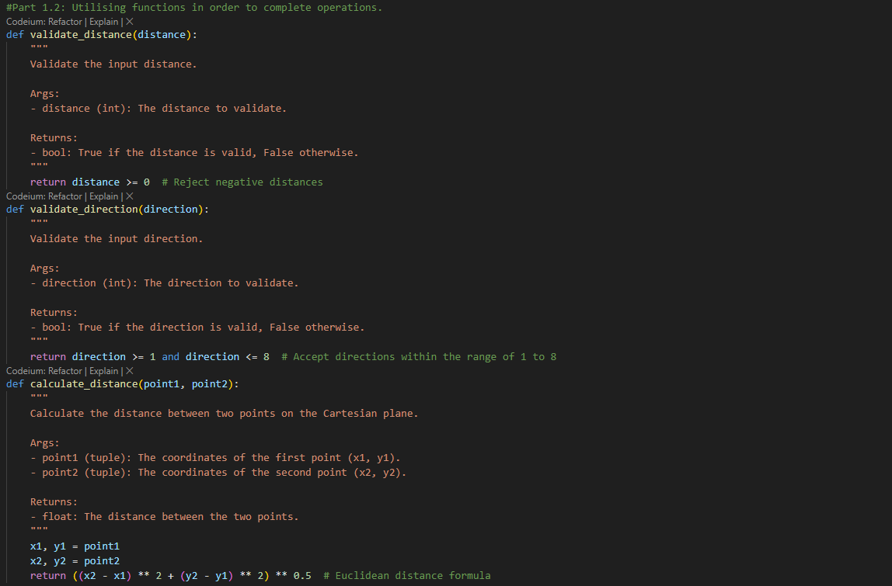
Explain
Function Usage: Ensure that all operations, calculations, and functionalities are encapsulated within functions. This promotes modularity, readability, and reusability of code.
Input Validation: Validate input data to ensure it meets the specified criteria. For example, we'll reject negative lengths and directions beyond the range of 1 to 8.
Custom Implementation: Instead of relying on built-in libraries like math, have own versions of functions to perform required operations. For instance, if distance calculation is needed, we'll implement our own function instead of using math.dist().

Slide 8
Example:
Example usage of input validation and distance calculation
point1 = (2, -4)
point2 = (-5, 3)
if validate_distance(calculate_distance(point1, point2)):
print("Distance:", calculate_distance(point1, point2))
else:
print("Invalid distance.")
Example of validating direction
direction = 10
if validate_direction(direction):
print("Valid direction.")
else:
print("Invalid direction.")

Slide 9
Part 2.1 to 2.4: (25 marks)

Slide 10
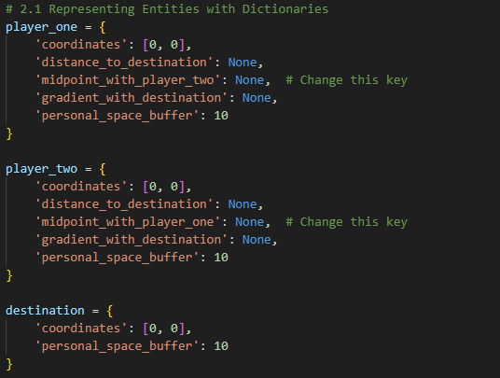
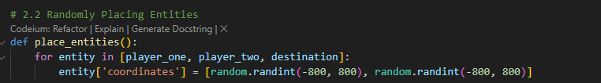
2.1 & 2.2
2.1 Representing Entities with Dictionaries (5 Marks) Create dictionaries for player_one, player_two, and destination, encapsulating relevant information about each entity, such as current coordinates, distance from the destination, midpoint coordinates to the other player, gradient with the destination, and personal space buffer.
2.2 Randomly Placing Entities (5 Marks) Using the Python random module, generate random integer coordinates within the range of -800 to +800 for player_one, player_two, and destination, and store them in their respective dictionaries.

Slide 11
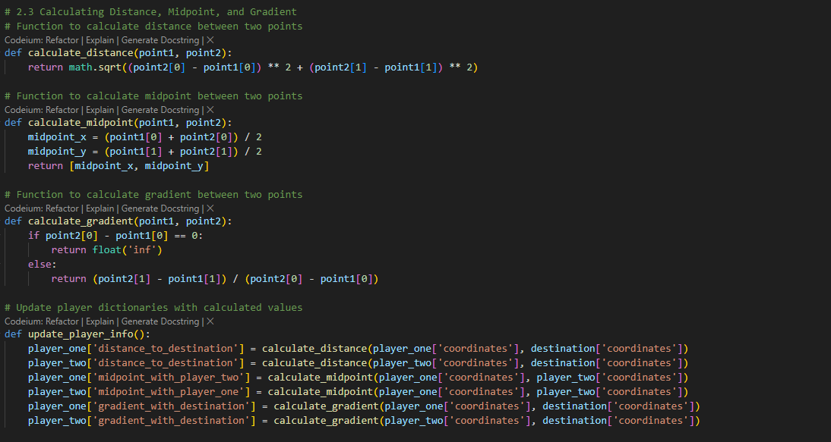
Part 2.3
2.3 Calculating Distance, Midpoint, and Gradient (10 Marks) Create functions to calculate the distance and gradient of each player to the destination, as well as the midpoint coordinates between the players. These functions will utilize custom implementations without relying on external modules.

Slide 12
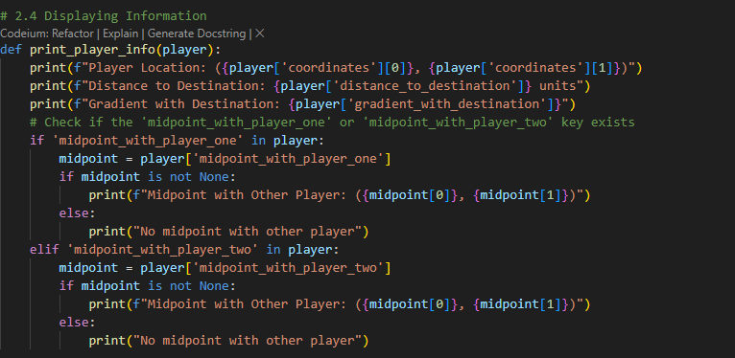
2.4
2.4 Displaying Information (5 Marks) Functions will be created to print information about each player and the destination, including their coordinates, distance to the destination, gradient with the destination, and midpoint coordinates with the other player. Aiming to reuse one function for printing player information to ensure modularity and consistency.

Slide 13
Example:
Example of entities, functions and printing
place_entities()
update_player_info()
print(f"Destination Location: ({destination['coordinates'][0]}, {destination['coordinates'][1]})")
print_player_info(player_one)
print_player_info(player_two)

Slide 14

Part 3.1 & 3.2
First integrate the necessary functionality into the existing codebase. We'll focus on implementing functions to check for a winner based on reaching the destination's personal space buffer and to move players along the hypotenuse of a right-angled triangle.
check_winner() function checks if a player has reached the destination's personal space buffer. move_player() function moves a player along the hypotenuse of a right-angled triangle by the specified distance and direction. update_game_state() function updates the game state after each move, including checking for a winner.
And an example usage demonstrates how to move a player and update the game state accordingly.

Slide 15
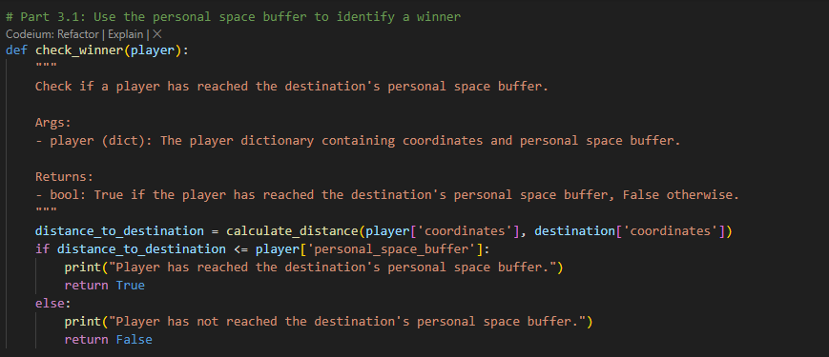
3.1
Identifies a winner depending on the personal space buffer provided (within 10 co-ordinates in all round directions)

Slide 16
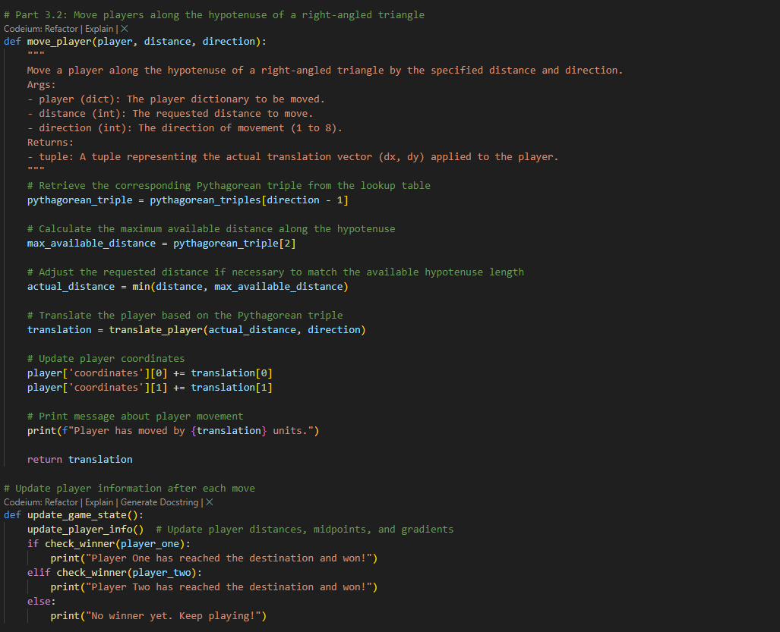
3.2
Write a function that accepts the requested distance and direction, and only move the player in the allowed distance in the requested direction.
After a player moves, the program will call the relevant function and display their updated information, as well as the destination’s information. The second human player can make use of this knowledge during their turn.

Slide 17
Part 4.1 to 4.3
Too long to put here; will explained in slides

Slide 18
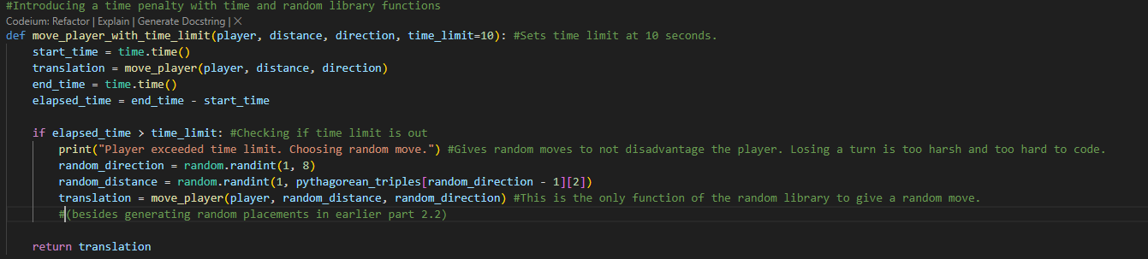
4.1
4.1 You can use the time module to track the time taken by each player to make a move. If a player exceeds the time limit (e.g., 10 seconds), you can choose a random Pythagorean triple and direction for their move.

Slide 19
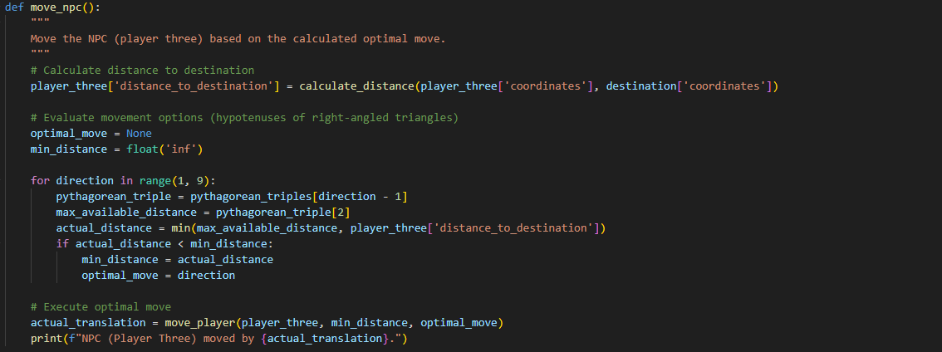
4.2
To design an NPC algorithm for player three, we need to create a strategy that allows the NPC to make intelligent decisions based on the game state.
Calculate Distance to Destination: Determine the current distance between player three and the destination.
Evaluate Movement Options: Analyze the available movement options for player three: Check the distances along the hypotenuse of right-angled triangles to see which one brings the NPC closer to the destination. Consider potential obstacles or other players' positions that might influence the NPC's movement. (ONLY makes the best moves.)
Choose Optimal Move: Select the movement option that minimizes the distance between player three and the destination. If multiple options are equally good, prioritize moves that avoid collisions with obstacles or other players.
Execute Move: Implement the chosen movement option by updating player three's position accordingly.
Update Game State: After the NPC's move, update the game state to reflect the new positions of all players and any other relevant information. Repeat: Continue this process for each turn of the game, allowing the NPC to make decisions dynamically based on the evolving game state.

Slide 20
4.3
You can use Pygame to create a visual representation of the Cartesian plane and the movement of players. Each player's position can be represented by a different color or shape on the screen. After each turn, update the display to show the new positions of the players.

Slide 21
Part 5
Defined the game's entities, directions, and the game's state (player_one, player_two, destination, game_state)
Created functions to manipulate the game's state (place_entities, update_player_info, move_player, move_player_with_time_limit, update_game_state, check_winner, print_player_info)
Created a game loop that alternates turns between the human players and the NPC (while True)
Added input validation to prevent invalid directions and distances (if direction: and if distance:)
Displayed the game state after each turn (print("\nUpdated Game State after [Player/NPC]'s Turn:"))
Checked for a winner after each turn and ended the game if a winner is detected (if check_winner([player]): break)
Finally, added some text-based user interface to make the game more interactive (input() and print() statements)
Implementing the game state: How I created the game using this selected code

Slide 22
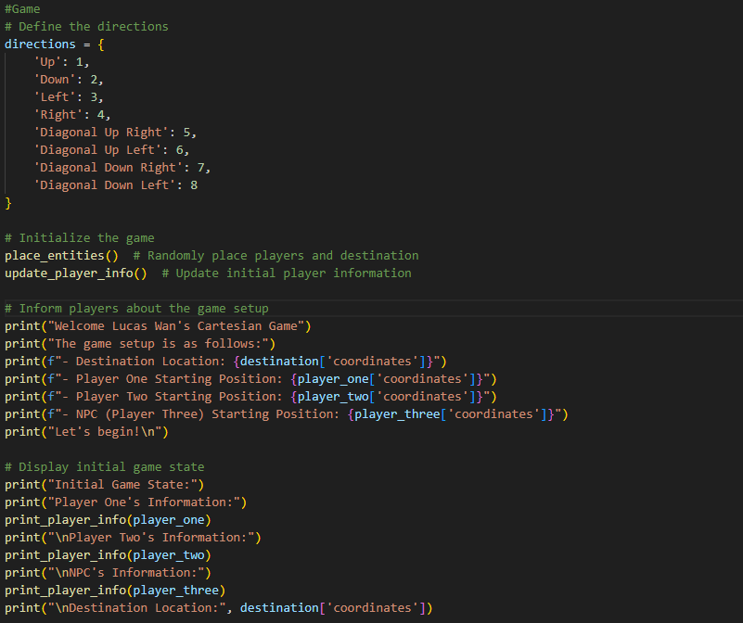
Game!

Slide 23
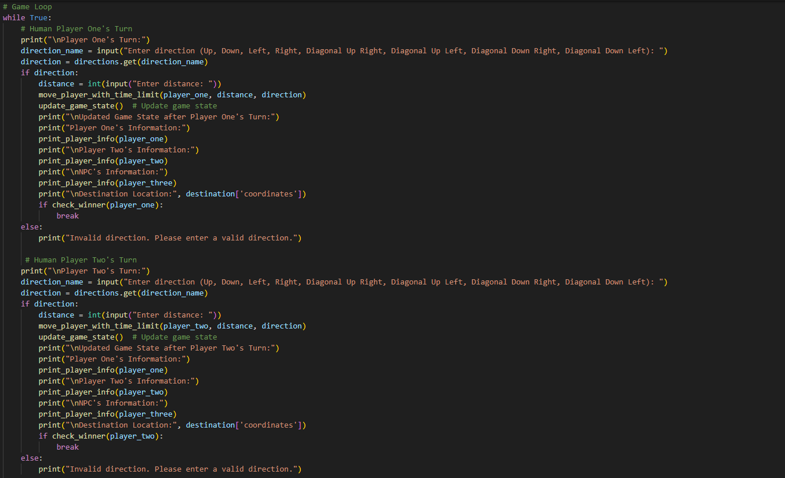
Game!

Slide 24
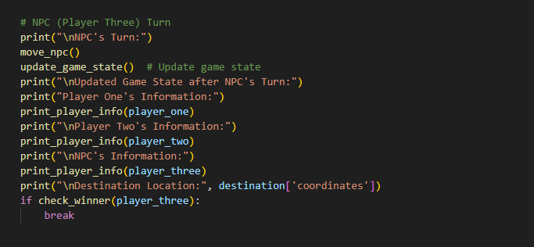
Game!

Slide 25
Thank you
That should have covered everything BUT the visual marks (2 marks)
Any questions or missing marks, I can go through the code explicitly for.
Lucas Wan

